Slide 1
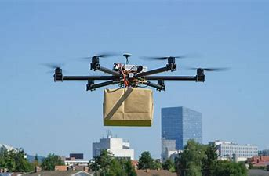
AIRWAY DELIVERY: A NEW BUSINESS OPPORTUNITY STRATEGIES
JAYANT SAXENA
PRIYANKA MUKHARJI
ANJALI OLHA

Slide 2
COMPANY ALL ABOUT
Your company is a courier company, which has branches across India and delivers to most pin-codes. Company's Board has decided to venture into 'Hyper Local Delivery space' and want to conduct local delivery through drones
They get all . As a rule, all flying objects in India, needs to take permission from (DGCA) Director General of Civil Aviation.
They can enhance there Busnies through Short Range Drone Based Services" instead of Long-Range Drone Flight operations due to high purchase cost of "Long range drones".

Slide 3
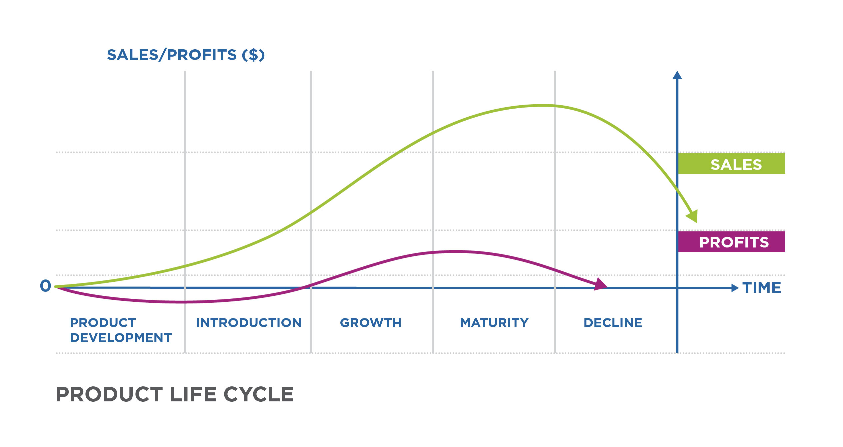
STRATEGY FOR EXPENSION
Through NPD
in initial stage they only stabilise there brand entity through (promotions,penetrations pricing strategy ) by which they attract more n more customers and this will help him to reach there break even point
Penetration pricing• It is a marketing strategy used by businesses to attract customers to a new product or service by offering a lower price during its initial offering. The lower price helps a new product or service penetrate the market and attract customers away from competitors

Slide 4
1 Diversify your offer lineup
Look into diversifying your offers. What complementary products or services or information can you offer in your business? In order to grow, you need to think about expansion. Identify new opportunities within your niche. Uncover the pain points. What else can you sell to your clients. Where else can you add value in the exchange

Slide 5
2.CREATE A WEBINAR
Webinars are a great way to promote any product or service. It can also help you grow any business relatively fast.
Webinars provide an automated selling tool for literally taking any product or service to market and reaching a wide audience quickly. The webinar medium is great for captivating audiences to clinch sale after sale, automatically

Slide 6
3.Consider a franchise model FOR LONF TERM SURVIVAL
. If you have a successful business, and you're really looking to grow quickly, consider franchising it.
Although franchise costs are high and moving to a franchise model is complex and takes a lot of marketing know-how, it could make all the difference if you're truly looking for quick growth.

Slide 7
4.Create a customer loyalty program
Loyalty programs are great ways to increase sales. It costs up to three times more money to acquire new customers than it does to sell something to an existing customer.
Other resources pin this number anywhere from four to 10 times more. However, any way that you slice it, acquiring new customers is expensive.
Frasier says that building a customer loyalty program will help you retain customers. It might also help you attract new ones as well. If there's a clear incentive to spend more money with you, it'll pay off in the long run. Build an attractive loyalty program and make it accessible to your existing customers and watch sales skyrocket over time

Slide 8
5 Research the competition.
When going to market, and you're really looking to get your offer to the masses, you need to research the competition. Frasier says he uses two platforms to conduct his research. The first is Similar Web. The other, AdBeat. Both provide competitive intelligence. It's your chance for x-ray lenses into all landing pages, ad copy, and other stages of the funnel.•
This allows you to uncover any advertiser's online strategy. Find the ads that have been running for the longest and emulate those. That's the quickest way you scale any business. If it's proven and it's working for your competitors, it's likely it'll work for you.

